Slide 1

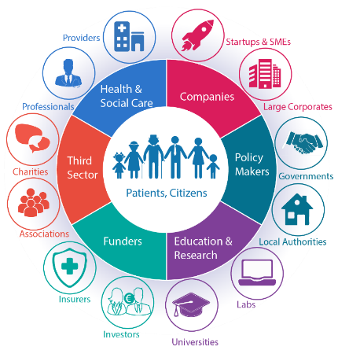





European Connected Health Alliance
Bringing needs and solutions together for the Future of Health
Highlands and Island Ecosystem
ECHAlliance
Overview
Andy Bleaden,
International Projects Manager
andy@echalliance.com
www.echalliance.com
@echalliance

Slide 2














About ECHAlliance
Member Organisation (650+ organisations - Join Us)
Companies, policy-makers, researchers, health & social care providers, patients, insurances…
who
16,500+ experts / professionals
Not for Profit Organisation
Registered in Ireland and in the UK (Community Interest Company CIC)
Growing reach across 40+ countries
Europe, USA, Canada, China & the Commonwealth
where
International Network of Ecosystems
(100+ ecosystem gatherings a year)
what
connecting & joining the dots
Communication
/ networking
Membership Support
International events
/ groups / workshops
H2020 projects, tenders & expert services

Slide 3
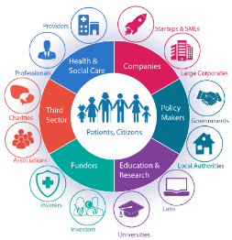
Purpose of an Ecosystem
The ecosystem goal is to create ‘permanent’ mutually beneficial partnerships, which improves the delivery of health and social care, at the same time as providing economic benefits.
An Ecosystem brings together a community of multi-sector stakeholders, interested in working, learning and exploring solutions to challenges facing your region.
The main benefit of working together in an Ecosystem is the multiplier effect and of collaborating in an International Network of Ecosystems.

Slide 4
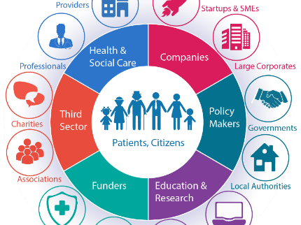
ECOSYSTEMS………………..
Break down silos,
transform healthcare delivery
and create economic growth

Slide 5
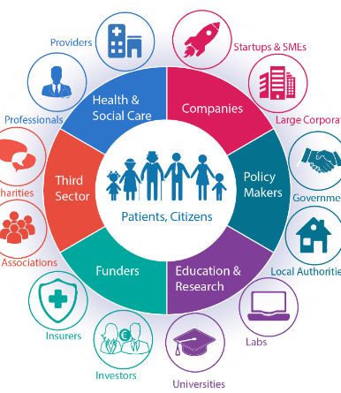

ECHAlliance Ecosystems:
Basic Principles
  Based on a geographic area
  Multi-sector stakeholders gathering
  Accessible to all (no barriers)
  Permanent, with regular gatherings
  Light governance via working group
  Shared strategy & action plan
  Lead with a need
  Member of an International network
  Patients / Citizens at the centre

Slide 6
ECHAlliance International Ecosystem Network - BENEFITS
Networking
Learning
Collaborating
Showcasing
DoING
business
Knowledge sharing
Funding
Global Reach
Building
Trust

Slide 7






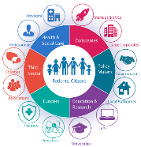
Members of the International Network of Ecosystems
100+ quarterly gatherings per year
Existing Ecosystems
  Greece - Athens
  Netherlands - Friesland
  Northern Ireland
  Portugal
  Republic of Ireland
  Serbia
  Scotland
  Slovenia
  Spain – Valencia
  Spain - Galicia
  Spain – Catalonia
  USA - New York
  Wales
Launching soon
Belgium – Brussels
Belgium - Flanders
Canada – Ontario
Czech Republic
Denmark – South
England – Manchester
England - North West Coast
England – London
England - Yorkshire & Humber
Estonia
Finland – Oulu
France – Nice PACA
Germany - Rheinland
Bretagne France
Lithuania
Highlands & Islands (Scotland)
Malta
Exploring Prospects
Africa
Austria
Australia
Canada
Finland
Germany
USA
Netherlands
Romania
UK

Slide 8

Ecosystems Priorities Matrix
Supports and encourages inter-ecosystem collaboration, greater engagement & H2020 Consortiums
Priority Area \ Ecosystem | Brussels (BE) | Catalonia | Estonia | Friesland (NL) | Galicia (SP) | Ireland | Manchester (UK) | North West Coast (UK) | Northern Ireland | Oulu (FI) | Scotland | Serbia | Slovenia | Southern Denmark | Valencia (SP) | Yorkshire & Humber (UK) | Greece
Electronic Health Records | P | S |  |  | S | P |  |  | P | P |  | P | S |  | S | P | N
Tele Health / mHealth |  | S | P |  |  |  |  |  | P | P | P | P |  | S
Mental Health |  | S |  | S | P |  | N |  | P |  |  | N |  | P | N
Preventive Care |  |  | P | S |  |  |  |  |  |  |  |  |  |  |  |  | P
Active Healthy Ageing (AHA) |  | N |  | S | P |  | S |  |  | S |  | N | N | S |  |  | P
Integrated Care | P |  |  |  |  | P |  |  |  | S | P |  |  | P |  |  | N
Medicines Optimisation |  |  |  |  | P | P |  | P | P |  | P |  |  | N
Analytics, BI, AI |  |  |  | N |  | P | S |  |  | P |  | P |  | P
Home Care |  |  |  | P |  | N |  |  | P | P |  | N
Health Tourism |  |  |  |  |  |  |  |  |  |  |  | S |  |  | S |  | P
Interoperability |  | S |  |  | S | N | N |  |  |  |  |  | S | S |  | P | N
Patient engagement |  | N | P | P |  | N |  |  |  | N |  | S | N | P
Funding, Financing, Support |  |  |  | N |  |  | N | P |  |  |  | N | N |  |  |  | N
Scaling |  |  |  |  |  |  |  | P |  |  |  |  |  |  |  |  | P
S = Strength
N = Need
P = Priority (not defined)
DRAFT - A work in progress

Slide 9





ECHAlliance - H2020 Projects
WE4AHA
supports the definition and execution of an Innovation to Market (I2M) plan, further development of the Blueprint to drive the policy vision on digital innovation, and the consolidation of EIP on AHA Action Groups and Reference Sites
Smart Healthy Cities (PULSE)
is a visionary project aimed at transforming public health from a reactive to a predictive system using heterogeneous data from numerous sources
Interoperability (TRILLIUM II)
reinforcing and scaling EU/US cooperation on Patient Summery to further advance global Electronic Health Record (EHR) interoperability
Active & Healthy Aging (SEED)
supporting the Recognition of the Silver Economy in Europe: Rewarding innovative solutions that demonstrate a significant impact on the quality of life of the ageing population.
Valentina Tageo, International Projects Lead – Project Services
Andy Bleaden, International Projects Manager

Slide 10

Ecosystems feedback approaches, testimonials
eHealth Ireland Ecosystem
a member of the ECHAlliance International Connected Health Ecosystem Network
Launched June 29th 2015 Ecosystem topics included:
ePharmacy Clinical Engagement Electronic Health Records The Lighthouse Projects 12 Months On Foundations of an EHR eHealth Driving the Innovation Environment Mental Health and Wellbeing | Partnering with Patients for Healthcare Innovation 2nd Joint Gathering- eHealth Ireland & Northern Ireland Connected Health Ecosystems eHealth Innovations for Home and Community Care Innovating for Sláintecare: Care Closer to Home Unlocking Data for Better Health Outcomes
Link: http://www.ehealthireland.ie/Stakeholder-Engagement/eHealth%20Ireland%20EcoSystem/

Slide 11

OuluHealth Ecosystem (FINLAND)
a member of the ECHAlliance International Connected Health Ecosystem Network
Feedback from OuluHealth Ecosystem: What guidelines would you offer to new ecosystems?
Ecosystem development is long term work
Trust among key partners is important – it takes time
Build on genuine strengths and expertise
Control is not possible – collaboration is key
Government support is needed
A crisis has positive effects -> need for change SME support or successes
Going abroad “OuluHealth Ecosystem” provides much greater visibility than being alone
What success stories can the Oulu Ecosystem share for other ecosystems?
My Data project supported and helped by the Oulu Ecosystem – led by CHT / City of Oulu - Finances CHT.
The FutureHealth initiative - I believe one reason Oulu was selected as leader for this project, was that we were working as an ecosystem (we stood out from other cities)
The hospital €500m refurbishment – shared and progress via Ecosystem. Piloting premises are built to serve also this investment, in collaboration among different ecosystem stakeholders.

Slide 12
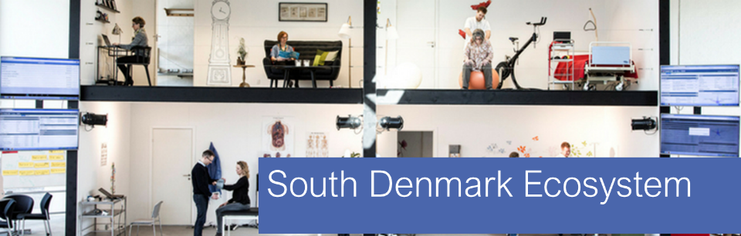
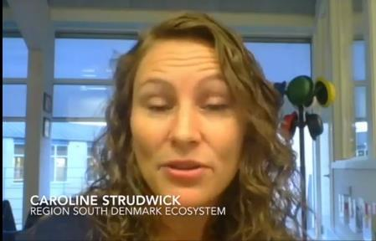
Caroline Strudwick, Specialist Advisor, International Coordinator
Health Innovation Centre of Southern Denmark
Video Link

Slide 13





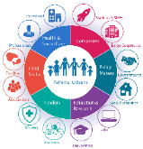

The Global Network of Digital Health Alliances
\
Connecting 78 Countries and 4.4 billion people
Canadian Integrated Health Alliance
China Consortium Health Alliance
Contact us info@echaliance.com

Slide 14

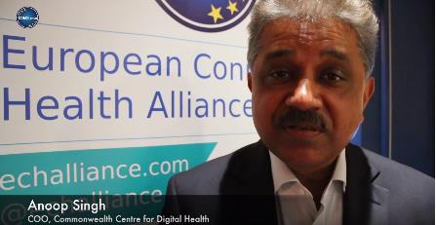
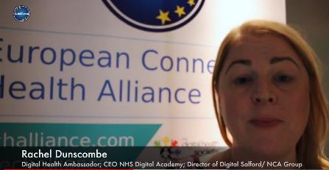
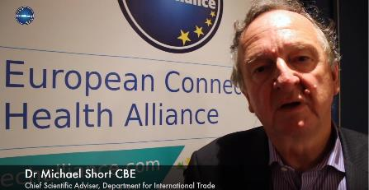
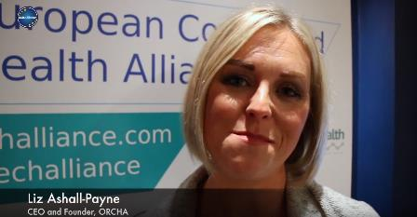
What are the benefits of being involved with ECHAlliance?
Video Link

Slide 15








The Digital Health Society
A multi-stakeholders initiative
launched in July 2017, under the Estonian EU Presidency
The DHS Task Forces
      Convergence roadmap on interoperability standards and Digital Telehealthcare protocol
      Led by Erik GERRITSEN, Secretary General of the Ministry of Health of Netherlands
      Citizen-controlled data governance & Data Donors
      Led by Angela BRAND, Professor at Maastricht University
      Legal framework facilitating the free flow and the 2nd use of health data
      Led by Bleddyn REES, Digital health expert and lawyer at Osborne Clarke
      Digital transformation & change management in Health & Social Care organisations
Led by Richard CORBRIDGE, Chief Digital & Information Officer, Leeds Teaching Hospitals NHS Trust
Get involved (DHS is open to all & no fees): Digital Health Society Update
Web: www.digitalhealthsociety.com
Email: dhs@echalliance.com

Slide 16


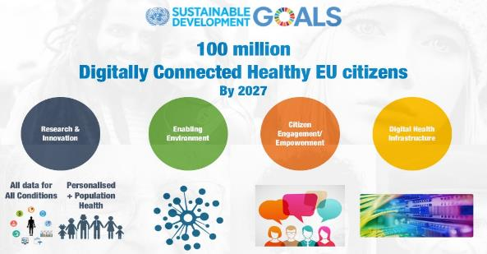
The DHS Moonshot
100 Million Digitally Connected Healthy EU Citizens by 2027
The DHS movement has designed an ambitious research and innovation programme for health and wellbeing in Europe, enabled by key support activities and involving the EU citizens and the whole society. Its purpose is not to define each project or initiative but to define a moonshot target and to describe the components of the programme to reach this goal.
The moonshot aims to develop a series of support activities and research & innovation projects, driving to collect the data (relevant for health purpose) of 100 million European citizens, by 2027, and make them available (under conditions) – read the full description of the moonshot.
Contact us: dhs@echalliance.com

Slide 17

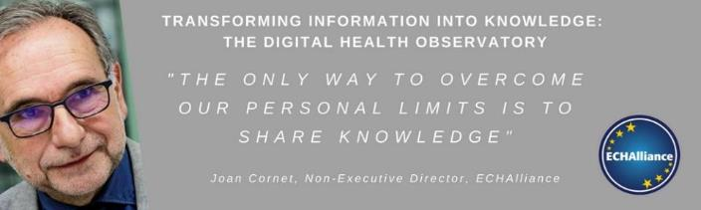
The Digital Health Observatory
an invitation to get engaged
ECHAlliance Digital Health Observatory, as a Global Connector section has 4 objectives to:
provide relevant, timely and high-quality articles, reports, best practices and research in digital health transformation.
increase awareness and commitment of governments and the private sector to invest in, promote, and advance in transforming healthcare delivery.
generate knowledge that will significantly contribute to the improvement of health using Digital technologies and processes.
disseminate research findings and best practices in events, workshops and through social networks.
Opportunity to share: high-quality articles, reports,
best practices and research in digital health transformation
Contact: joan@echalliance.com www.digitalhealthobservatory.com

Slide 18



ECHAlliance Membership: Recent New Members
JOIN US NOW!
www.echalliance.com
under ‘Members

Slide 19

Andy Bleaden
International Projects Manager
ECHAlliance
andy@echalliance.com

Slide 20
Loneliness, Social Isolation,
& Health
Hugo van Woerden
&
Cathy Steer

Slide 21
Loneliness &Isolation Kills
Loneliness
Mortality over six years
Lonely – 22.8% Not lonely 14.2%
Social Isolation
Mortality (men) over eight year
Low social integration 7% High social integration 1.4%

Slide 22

Social Relationships (1)
People with 2 or more close friends are 20% less likely to be poor
A small number of meaningful relationships may be better than a large number of acquaintances

Slide 23
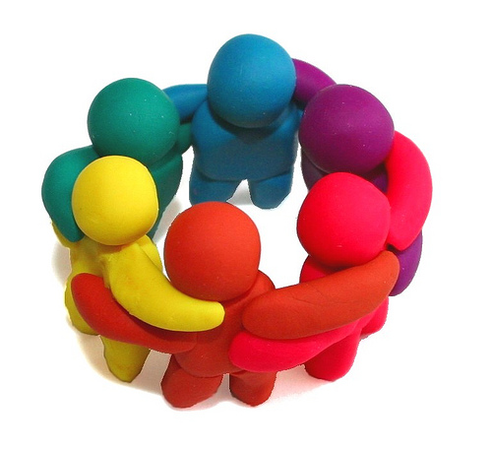
Social Relationships (2)
Strong social bonds can ease financial deprivation as friends and relatives can:
  lend money
  pool risk
  mind children
  provide respite
  bring news of job opportunities

Slide 24

With a little help from my friends
 | Percentage who had nobody to rely on in times of need
Most deprived | 30%
Least deprived | 16%
‘Social Isolation’. The Economist 6 June 2015

Slide 25
NHS Highland Survey
3,000 aged 65+ yrs – random sample
(22% of our pop is 65+ yrs)
1,539 (51.3%) returned
1,119 (73%) valid
Responses were anonymous
Notes:
22% of the Highland population are 65 and over. We wanted to know if loneliness is an issue in Highland – the logical step was to measure it so we surveyed 3000 men and women 65 and over.
This group was picked as we have an aging population in Highland and it allowed us to collect enough numbers to make the data valid. (money was also a factor).
They were posted a survey and freepost return envelope with a closing date of 29th July 2016
We expected a 10-20% return rate and were surprised to receive over fifteen hundred responses.

Slide 26
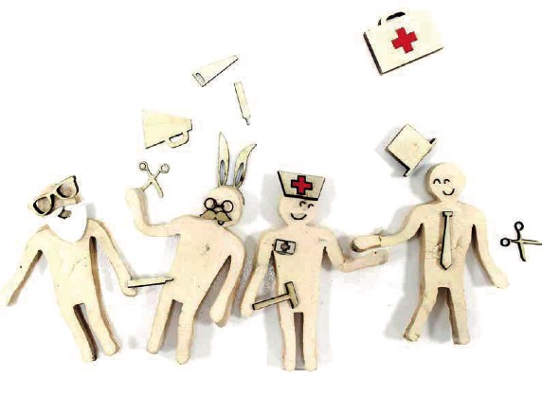

The value of a design approach to rural mental health and ageing research
Dr. Tara French
The Glasgow School of Art Rural Mental Health Ecosystem Nov 2018

Slide 27
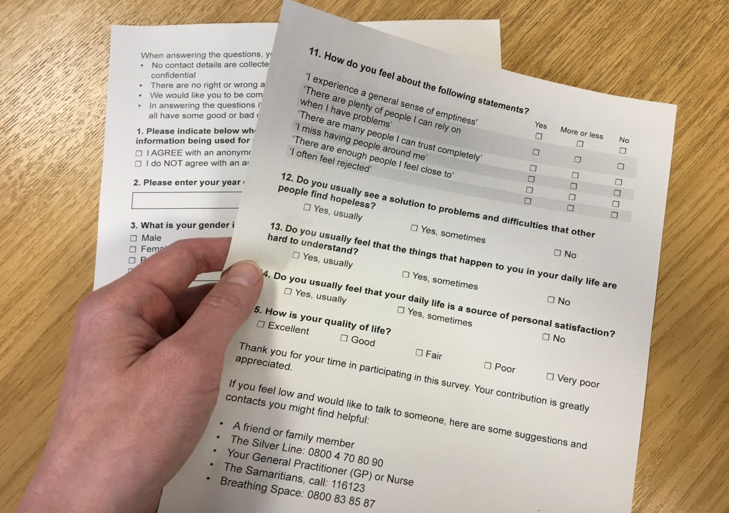
Measures
6-item De Jong Gieveld Loneliness scale
3-item Sense of Coherence scale
1-item Quality of Life
Personal
details (age, gender etc)
Notes:
We used the 6 item De Jong Gieveld scale which is validated and robust loneliness measuring tool which contains 6 questions.
It provides us with a score for emotional, social and total level of loneliness. We used this as it is validated for use in Europe and with older populations, it can be delivered verbally or in written form and is seen as the Gold standard measurement tool.
We also used a three question sense of coherence scale and one question about the participants perceived quality of life.

Slide 28
Emotional and Social Loneliness &
Sense of Coherence (SOC)
Emotional Loneliness: is a feeling of missing an intimate relationship
Social Loneliness: is a sense of missing a wider social network such as lacking friends or family
Combined Loneliness: is the score from combining the social & emotional loneliness scores
SOC: reflects ability to cope with difficult or stressful situations
Notes:
The six item scale splits loneliness into emotional, social and total loneliness which provides us with a clearer understanding of the type of loneliness experienced by participants. We might expect that living in rural locations in Highland lead our residents to feel more socially isolated – well we will find out if this assumption is true in a minute.
This tool tells us if the respondent experiences some level of loneliness – this measure groups those who feel lonely all the time, often or sometimes, and a if they experience intense loneliness – which equates to often or always feeling lonely.

Slide 29
Summary of Results
67% experience some level of loneliness
8% experience intense loneliness
Notes:
Its widely quoted that around 10-13% of the older population experience severe loneliness – our results indicate that our population experience slightly lower levels of severe loneliness than this group.
Victor et al 2005 found that 38% of older people experience some level of loneliness – our survey showed 67% of our respondents experienced some level of loneliness.
Lets dig down into the data

Slide 30
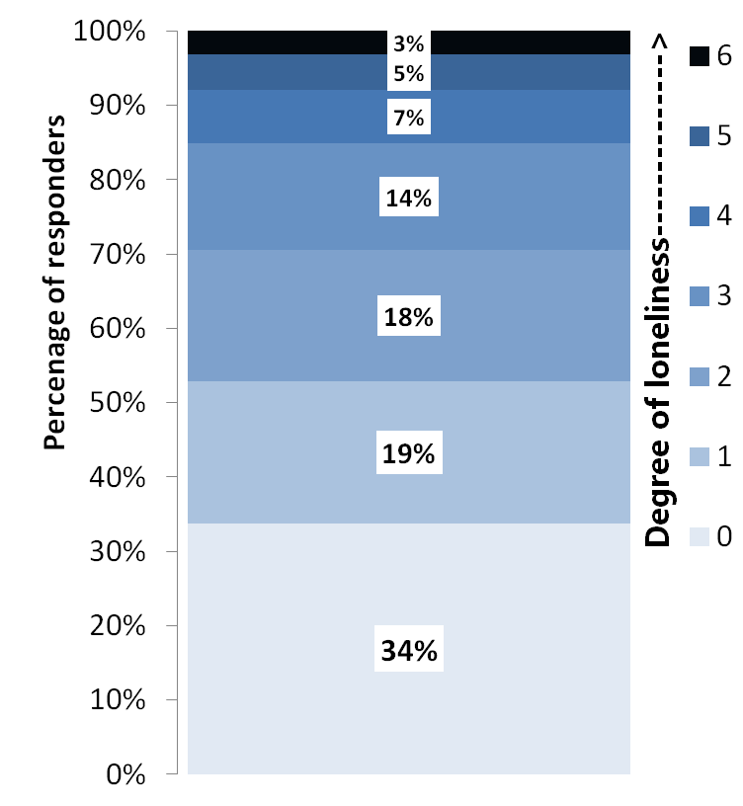
Degree of loneliness

Slide 31
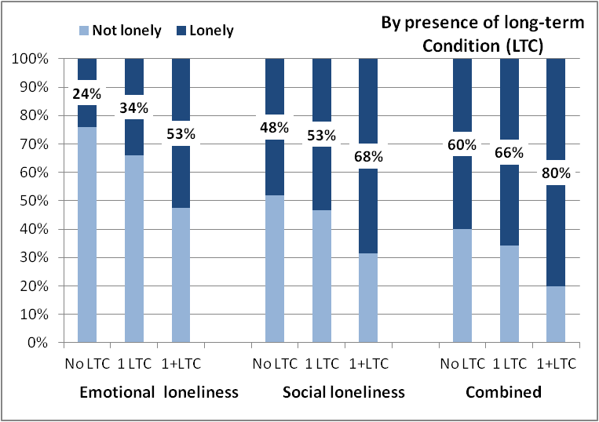
Long term conditions

Slide 32
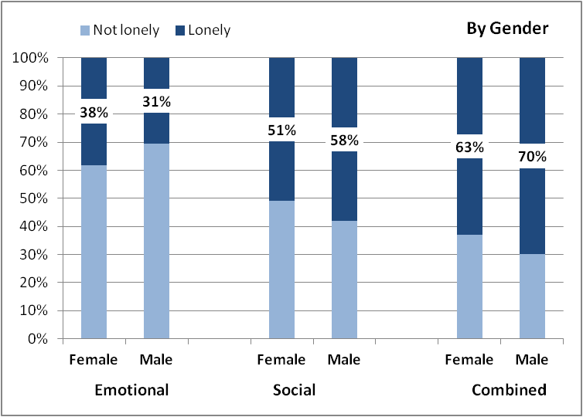
Gender

Slide 33
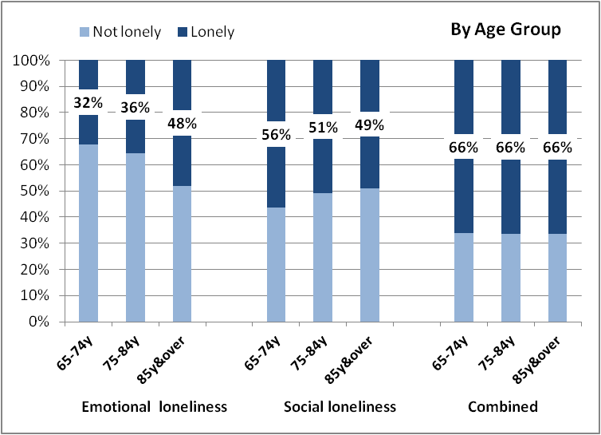
Age

Slide 34
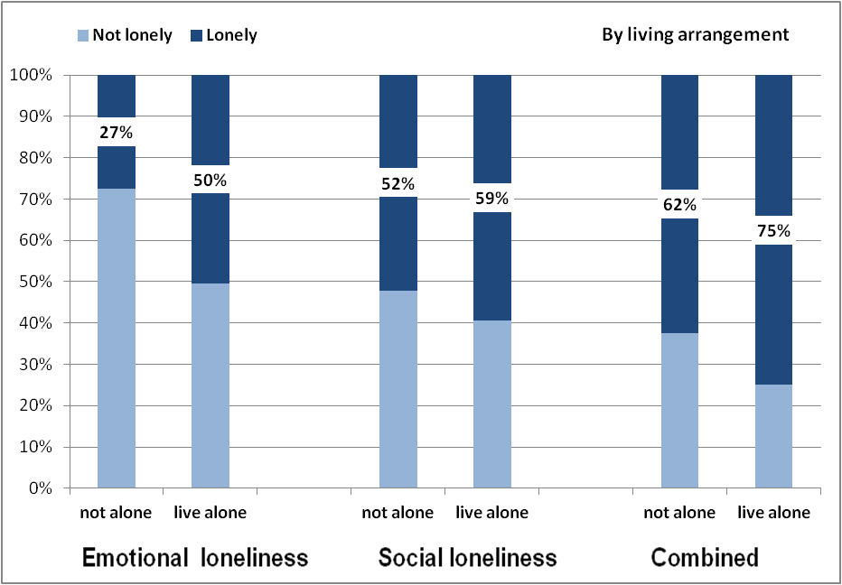
Who is at home?

Slide 35
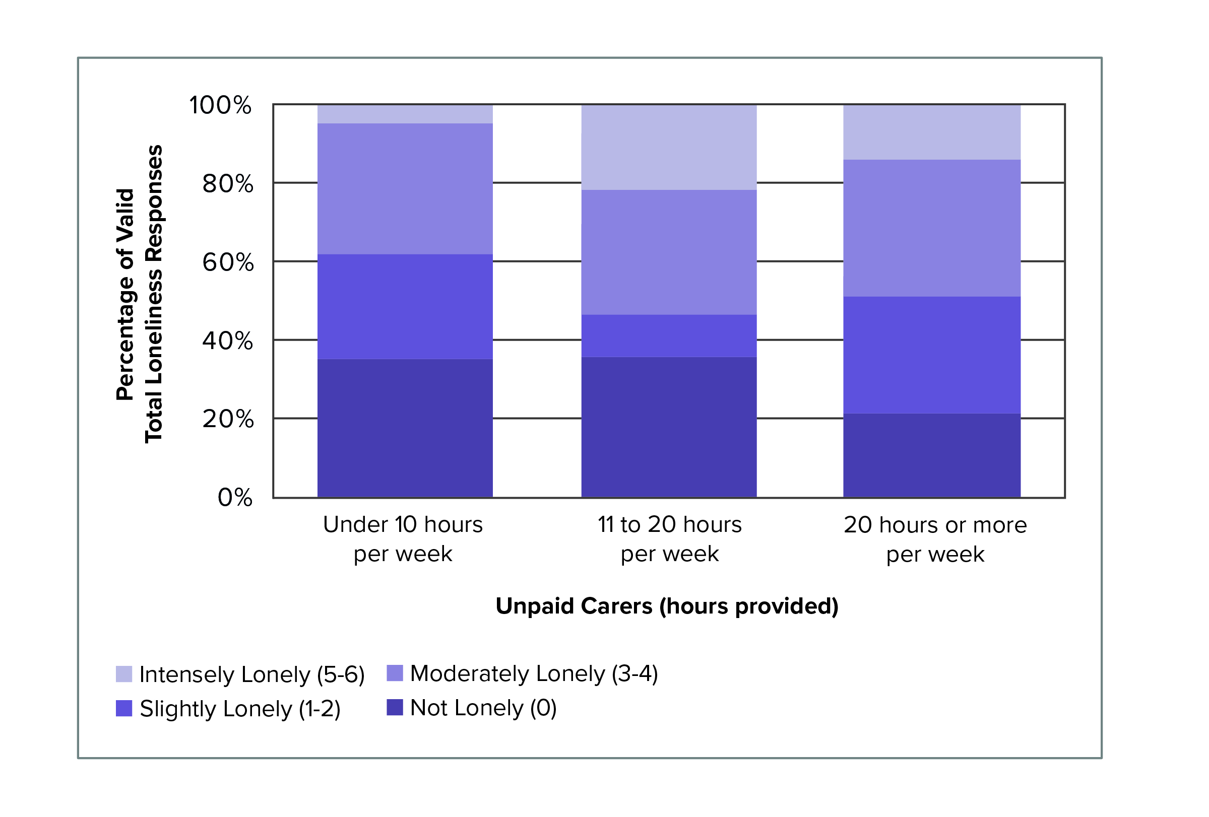
Caring for others

Slide 36
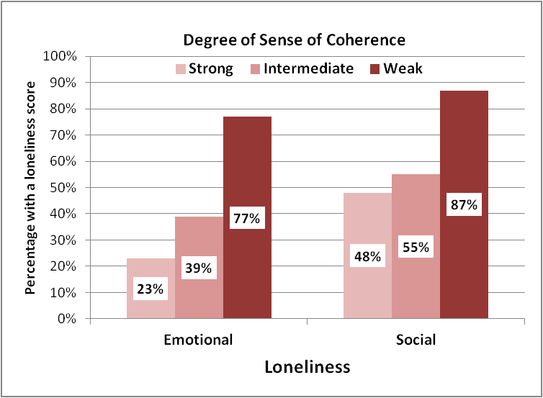
Relationship with Sense of Coherence

Slide 37

Other risk factors for loneliness
(our survey)
Living in ‘very remote rural areas’ or ‘very remote small towns’
Having a disability

Slide 38
Protective Factors for loneliness
(our survey)
A strong sense of coherence
Living in a town or accessible rural area
Married and living together

Slide 39
Outcomes for some projects
Befriending - investing £80/year produced a cost saving of £300/year
A arts based community activities reduced need for acute hospital care by €943/person/year

Slide 40
Opportunities?
Befriending
Social groups
Community transport schemes
Walking groups
Volunteering
Community development and community based activities

Slide 41
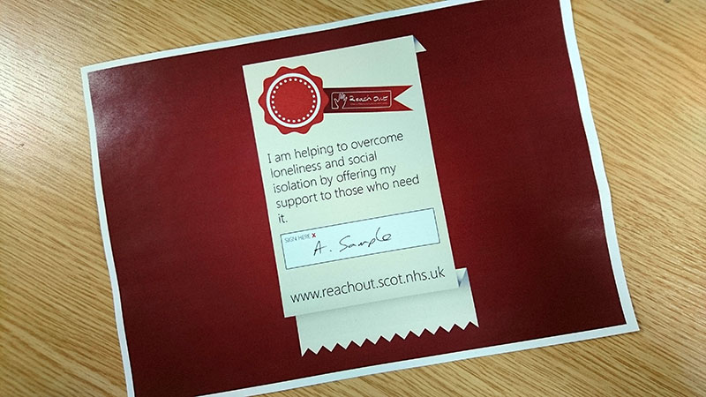
Reach Out Campaign make a difference to someone who’s lonely
Encourage people to talk about this issue
Get local communities
to “own” solutions
Not simply a health
and social care issue

Slide 42
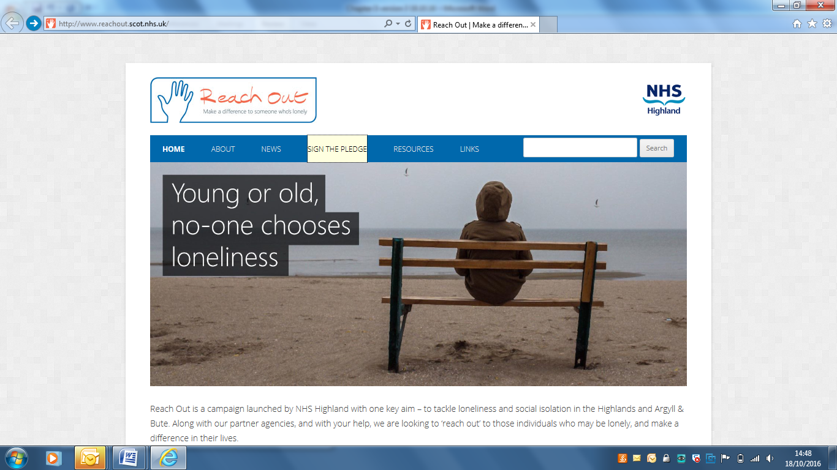

Slide 43
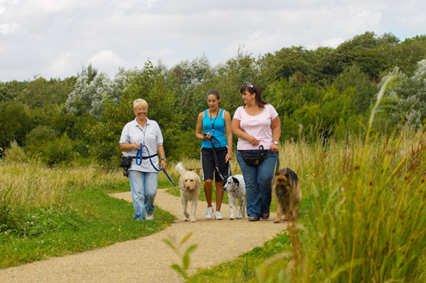
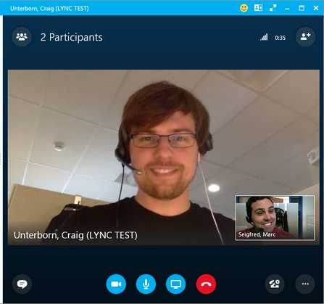
Stories

Slide 44
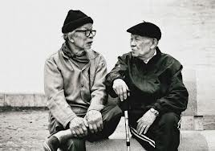
Conclusion
Loneliness – major cause ill health
Opportunity
for us all to get
involved
Thank you

Slide 45

Design research for complexity
Exploration and creation of ‘preferable’ solutions to complex societal challenges to
innovate systems, pathways and experiences of care.
Services, systems, interactions and health and care experiences
Practitioners, people with lived experience, academics and industry partners

Slide 46
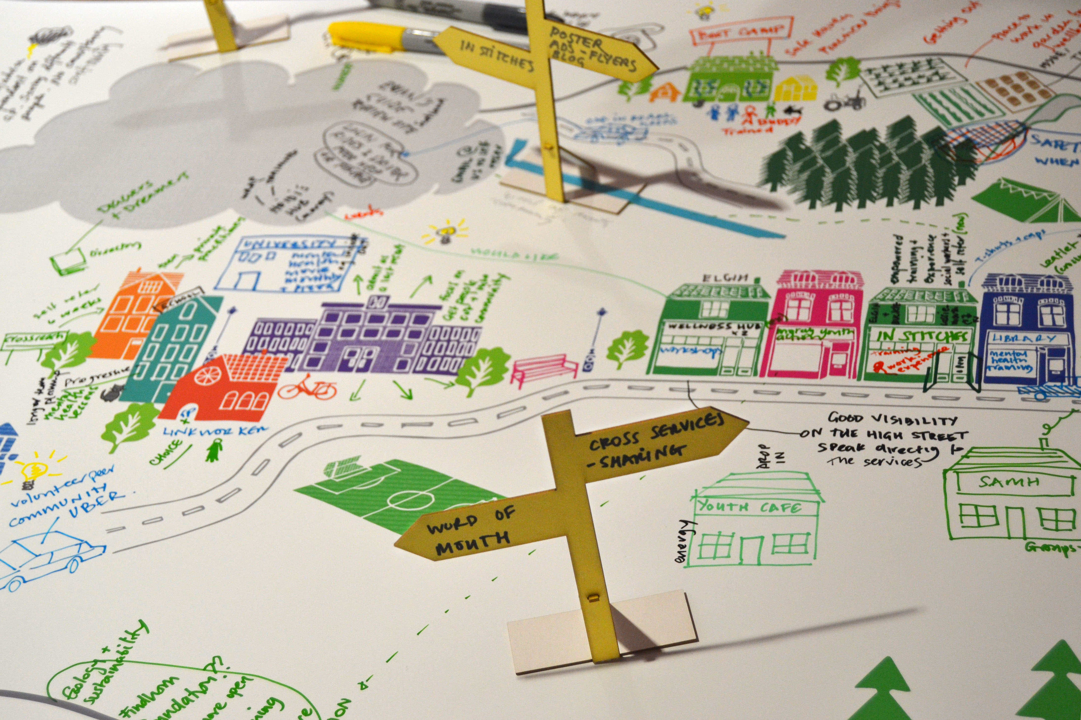
Complex landscape of Mental Health services

Slide 47
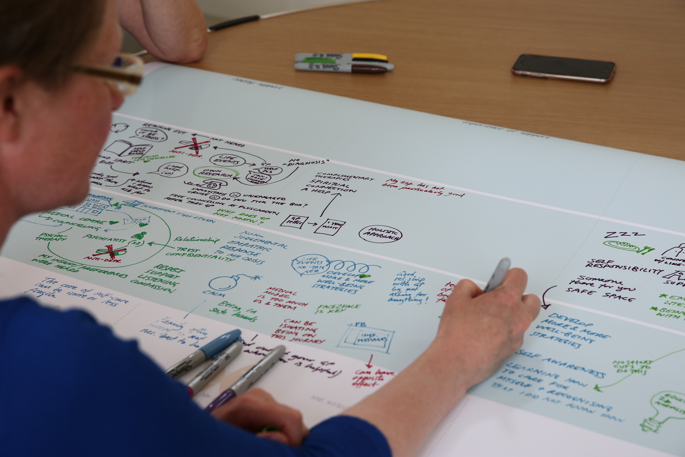
Journey mapping lived experience

Slide 48
Notes:
The cyclical, relapsing and remitting nature of many mental health experiences meant that people needed to find and access support intermittently, which was a challenge if circumstances had changed i.e. moving to different location, changes
The ‘finding support’ stage tended to be focussed around self-initiated support and information seeking through various approaches such as online, through the health service or by meeting other people with similar issues.
A central barrier to finding support was not knowing what to look for, where to look or who to ask. Finding information took long periods of time and participants often felt they had to seek out information themselves and lacked an overview of what was out there.
Participants reported that everyone needs help to find a form of support that will work for them, and relationships were also stressed as important in order to find the health and care professional and peers that work well with the person. The type of support also differed according to the stage of the journey/trajectory, with different services supporting different needs. The different types of services described included: National Health Services (NHS), charity and third sector organisations, and
self-management through using the knowledge they had gained about themselves during their journey to better understand what worked for them. This also involved recognising the signs and symptoms that indicate they may need additional support.

Slide 49

Dr Bruce Armstrong
Bruce Armstrong, Highland Area Manager

Slide 50
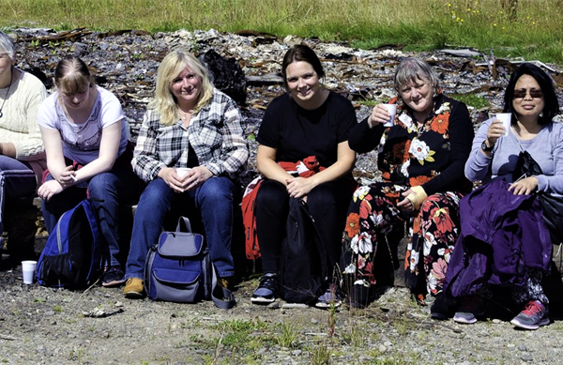
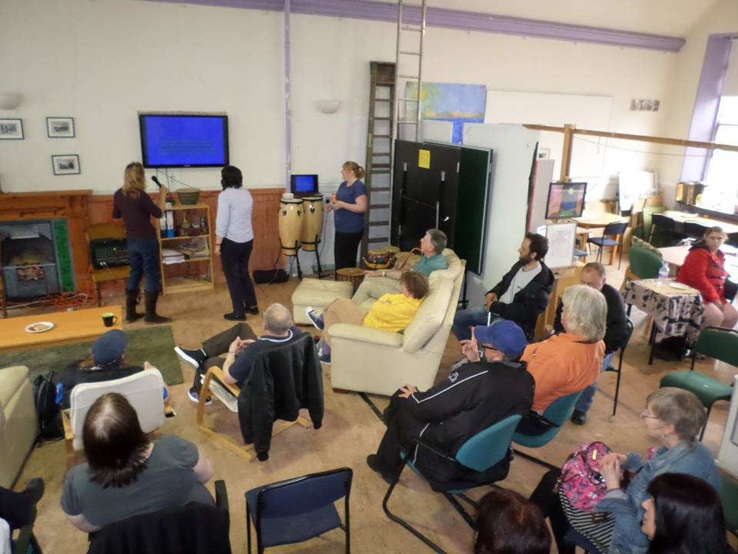
A membership organisation

Slide 51
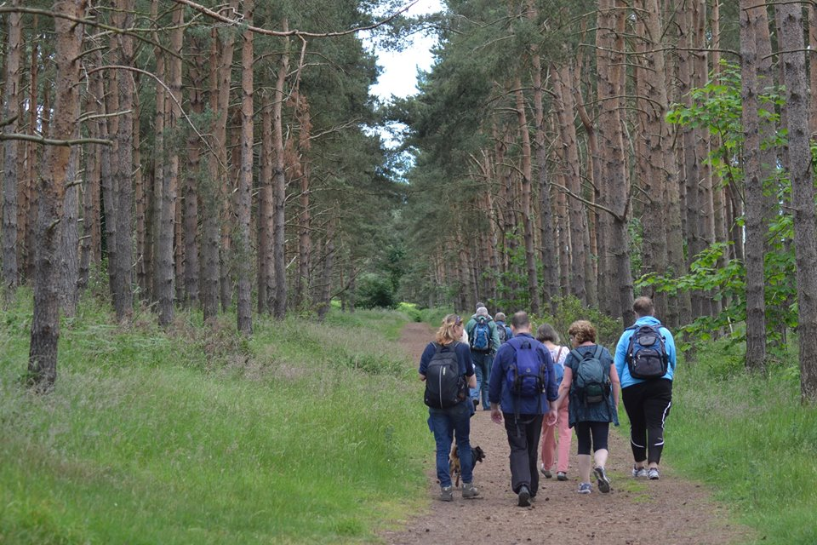
A membership organisation
Our aim is to improve the quality of life for anyone whose mental health problems or mental illness has a serious impact on their life and on the lives of others, including family members, friends and supporters

Slide 52
History
Founded in 1972 as the National Schizophrenia Fellowship
Independent Scottish charity since 1984
Founding member of Mental Health UK,
with Hafal, Mindwise and Rethink

Slide 53
In the Highlands
Supporting over 150 people in their recovery every week, through person-centred, outcome-focussed support work
Resource Centres in East Sutherland, Easter Ross and Lochaber
Outreach projects in East Sutherland and Easter Ross
Specialist projects

Slide 54
Mental Health and Money Advice Service
In partnership with Mental Health UK and Lloyds Banking Group
Online information www.mentalhealthmoneyadvice.org
Telephone advice service by referral

Slide 55
Distress Brief Intervention
Scottish Government pilot programme
November 2016 to April 2021
Support in Mind Scotland is lead partner for the Highland test site
… with NHS Highland, Police Scotland, Scottish Ambulance Service, Primary Care

Slide 56
Distress Brief Intervention
Enhanced response to people presenting in distress to front line services
Rapid referral to specialist support team
14 days of solution-focussed support
Supported signposting and referral

Slide 57
The Solas Project
Big Lottery Fund project
Specialist support for people who have a Community Treatment Order
… or other compulsory measures
Complementing statutory support with a focus on recovery and personal goals

Slide 58

National Rural Mental Health Forum
A network of rural people and stakeholders
Notes:
enable rural people to be open about their mental health
create a solid evidence base for what works to improve people's lives
create a programme to influence policy-makers to channel resources in ways that bring positive change through a network of rural organisations across Scotland

Slide 59
National Rural Mental Health Forum
60 member organisations
Scottish Government funding and support
www.ruralwellbeing.org

Slide 60

Well Connected Communities
Research and consultation on rural Mental Health carried out in the Western Isles, Argyll and Bute and 3 other rural areas
Published May 2018
378 respondents

Slide 61
Well Connected Communities
Importance of people suffering poor mental health having safe places to take part in their local communities
Difficulty of isolation, particularly when transport options are scarce
Problems created by stigma

Slide 62
Well Connected Communities
- Key Findings
Supportive communities
Low-level, non-clinical support
Existing useful support
Connections and local assets

Slide 63
Well Connected Communities
- Key Findings
Change one thing …
    Easier access to support
    More awareness of mental health, to develop acceptance and change attitudes

Slide 64
Well Connected Communities
- some key points
Community development approaches in genuine partnerships with local people, who know what is best for them and what can work in their area

Slide 65
The rural dimension and the future
Expanding the model of support
Enabling community development towards whole-place approaches to mental well-being
Promoting inclusion through community partnerships

Slide 66
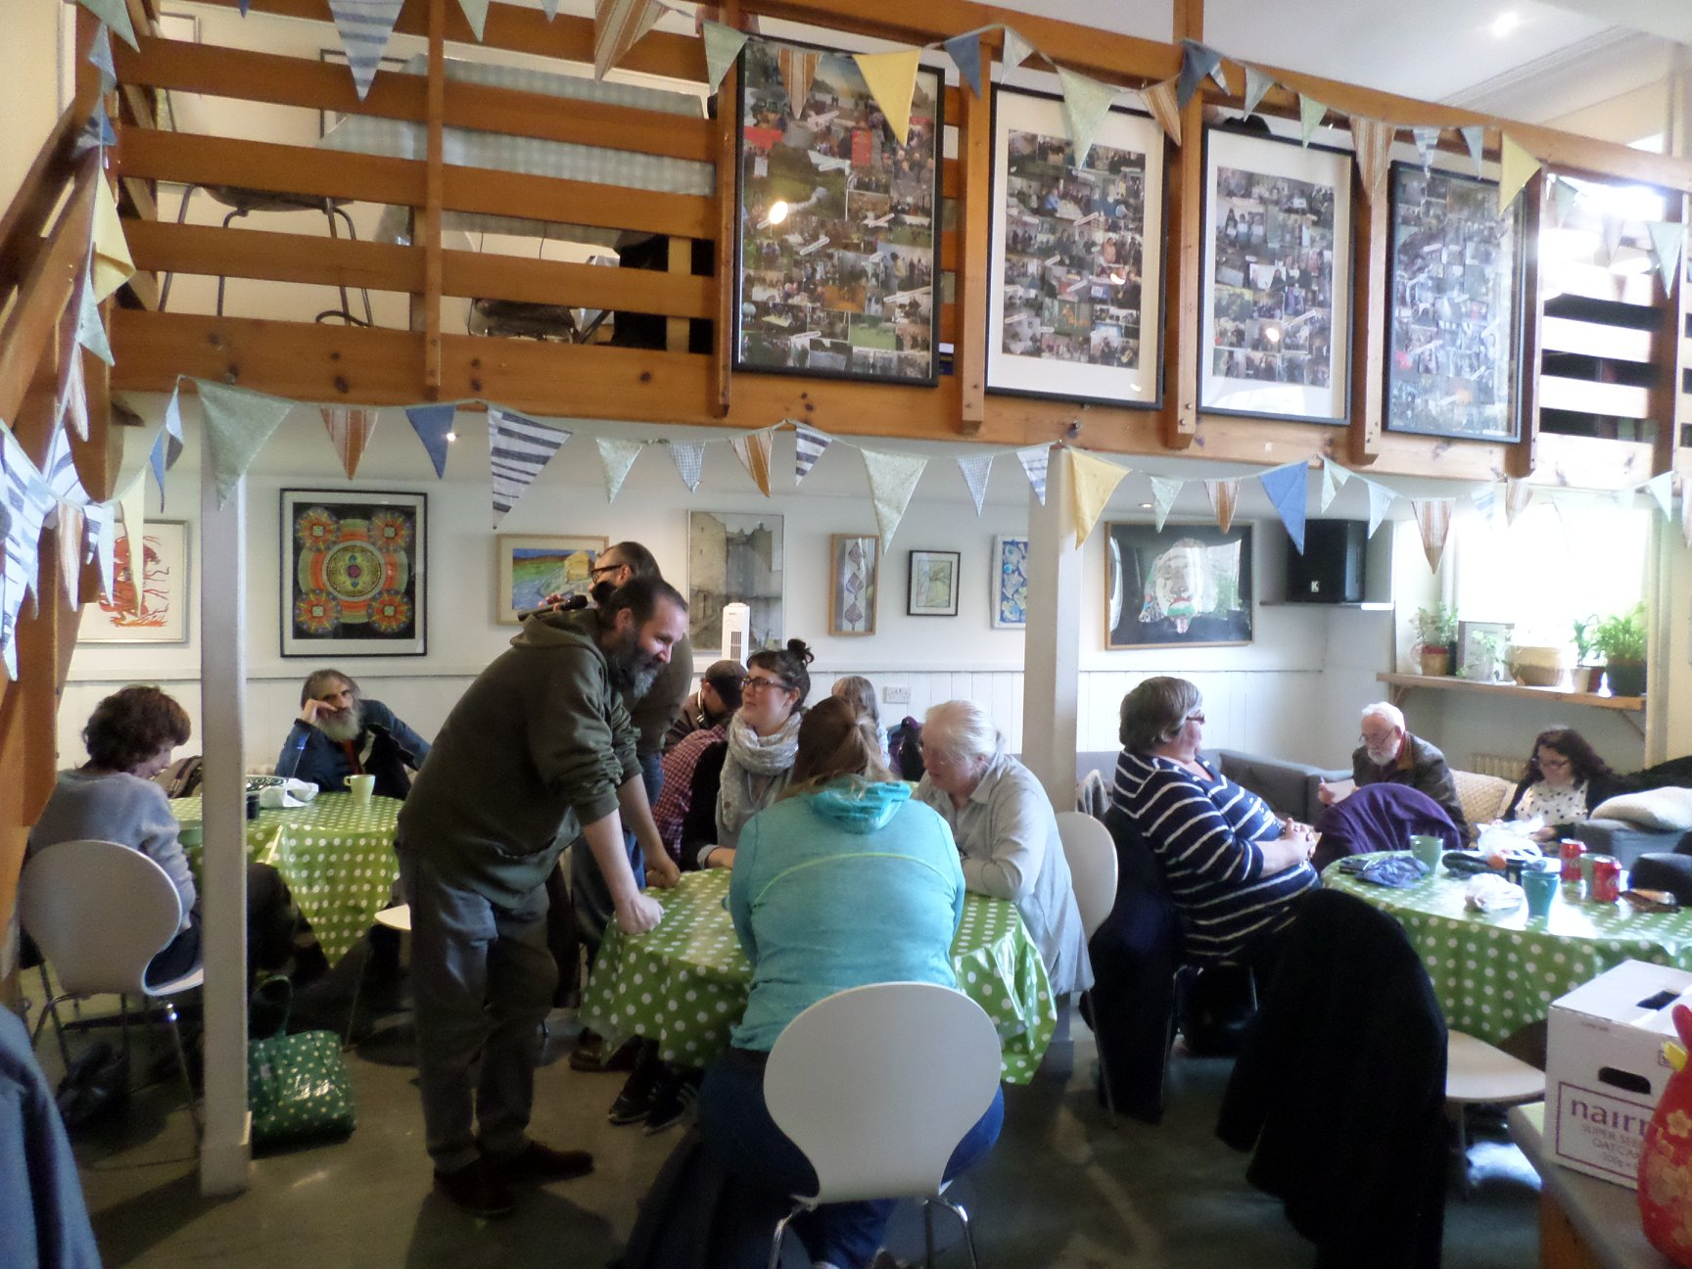

Slide 67









Openbrolly - Sample Digital Health Projects
IBD NHS portal
Patient reports symptoms & communicates with care team.
Virtual Hospice
Access to a personalised digital care library.
Diabetes Personalised Exercise Recommender
Case Based feasibility with RGU, UHI, Diabetes Scotland
Capsule Endoscopy
Anonymised transfer of capsule endoscopy orders to German-based supplier; transfer of reports to NHS.
2016/18
2018
2014
2015
2016
2017
My Cancer Portal II/III
TCAT funded collection of symptoms and holistic concerns for colorectal cancer patients; AI signposting personalised around concerns. Integrated with health record. Extended to NOSCAN, prostate.
PHASE - Mental Health
System design / co-production of AI driven signposting system for people with learning disabilities and young adults. Aims: Self-management in supported care pathway, improved coordination between stakeholders. Operational and efficiency savings.
2014 - Scottish Life Sciences award
Commercial collaboration.
2017 - Scottish Life Sciences award
Innovative collaboration.

Slide 68
Supporting Self Management
Dr Tim Agnew,
Consultant Psychiatrist and Psychotherapist

Slide 69
Overview
The development of mental ill health
Resilience
Supporting self management

Slide 70
Physical health problems
Mental disorders
Current environmental factors
Social problems
Health harming behaviours
Chronic Toxic
Stress
Moderators
Biopsychosocial conditions that:
Raise themes or concerns eg threat-anxiety; loss-depression
Shape responses through modelling, observational learning and reinforcement eg violence vs sports; slimmness and dieting over-praised
Change the value of stimuli eg high reward sensitivity for alcohol; hunger will increase reinforcement value of food
Social, cognitive and emotional impairment (Proximal Risk Factors)
Disrupted neurobiological development and allostatic load
Congenital factors (Biological Distal Risk Factors)
Chronic Toxic Stress
Adverse and traumatic experiences including ACEs (Environmental Distal Risk Factors)

Slide 71
But not everyone who experiences adversity will develop problems...
Why not?

Slide 72
Resilience
Modern concepts of resilience originated in studying groups of young people who had been exposed to ACEs
Some developed social, physical and mental health problems and some did not
The set of characteristics found in the set of young people who were less negatively affected by adversity was termed “resilience”

Slide 73
Some components of resilience
Emotion regulation skills
Problem solving skills
Sense of self-agency
Hopefulness
Effective interpersonal relationships

Slide 74
Resilience building
The brain is plastic and the body wants to heal
Practices that build resilience can change chronic toxic stress into tolerable stress, the brain can slowly undo many of the stress induced changes and the body can start to recover
Furthermore, if parents make these changes, it can help reduce intergenerational transmission of ACEs

Slide 75
Supporting Self Management
Supporting Self Management Skills Training includes:
  Emotion regulation skills
  Problem solving skills
  Relationship skills
Application of these skills in vivo leads to:
  Improved emotion regulation effectiveness
  Increased interpersonal effectiveness
  Enhanced overall self management effectiveness
Leading in turn to:
  Improved sense of self-agency
  Increased hopefulness
  More effective interpersonal relationships

Slide 76
Who is likely to benefit from this approach?
People who display the two primary characteristics of mental ill health
People who are able to learn and apply new skills
People who are motivated to learn and apply new skills in working towards better mental health

Slide 77
The two primary characteristics of mental ill health
Distress
  aka problems in emotion regulation
Dysfunction
  aka problems in self management
Skills remediation for emotion regulation and broader self management difficulties can form a key component in responding to mental health problems across diagnostic categories

Slide 78
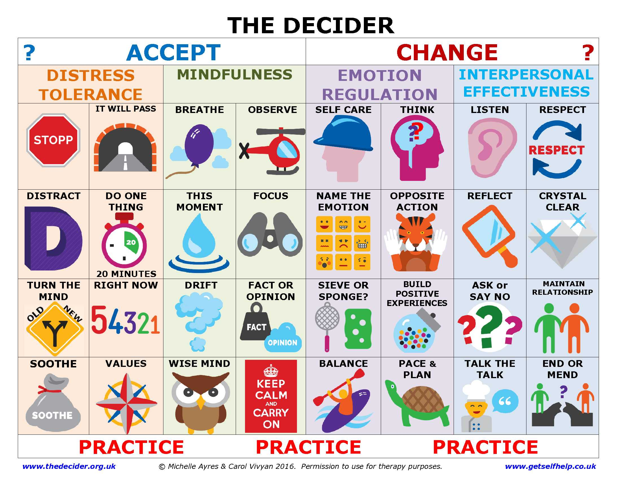

Slide 79
Thank you.
timothy.agnew@nhs.net
http://tinyurl.com/PDICPHighland
http://tinyurl.com/HighlandDecider
www.acestoohigh.com
www.thedecider.org.uk
www.getselfhelp.co.uk
www.cdc.gov/violenceprevention/acestudy/
www.cph.org.uk/case-study/adverse-childhood-experiences-aces/
www.acestoohigh.com
https://www.youtube.com/watch?v=4x35DyHwfto (STOPP Skill)
https://www.youtube.com/watch?v=YiMjTzCnbNQ (Welsh Public Health ACEs video)
https://youtu.be/sYNVvarBE5Y (NHS Health Scotland video)

