Slide 1
LTA Connect
The People, Progress, and Partnership of the Student Voice Representation System
Notes:
HF to introduce session?
AT to do general introduction

Slide 2
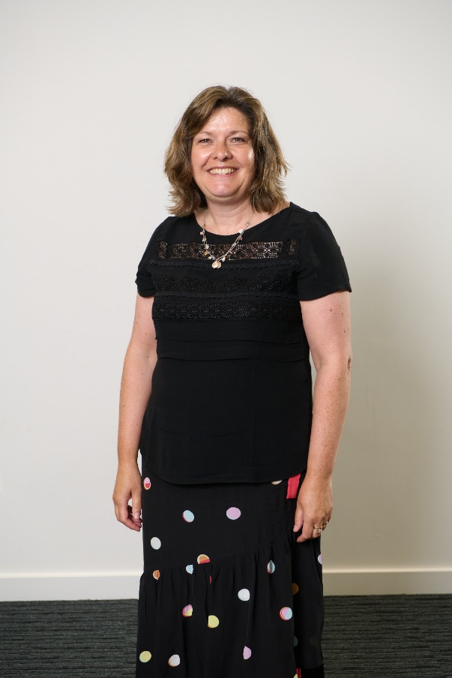
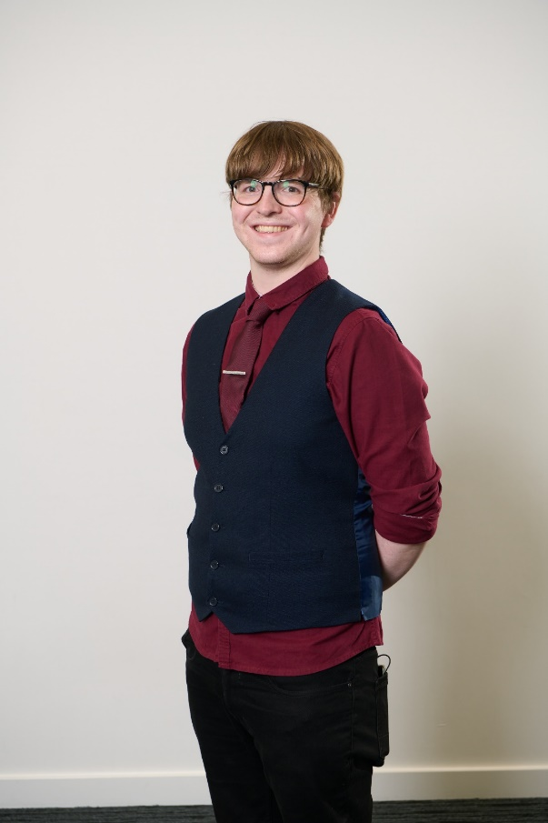
Presenters
Anna Templeton Student Voice Manager
Aimee Harvey
Student Development Officer
Andrew Bowie Advocacy Development Associate
Notes:
AT to do general introduction
AT to remind folk to save questions for the end (or to pop them into chat)
AH to collect and Q’s that come in in the chat

Slide 3
Section 1: HISA Staff & Officers
Notes:
AT

Slide 4
INTRODUCTION TO HISA
21 officers (3 regional, 18 local)
Representing all students regionally, and 11 of 12 partners locally
Some partners have more than one officer:
- Perth: 3
- Inverness: 3
- Moray: 2
- Shetland (Structure under review following merger)
Notes:
AT

Slide 5
INTRODUCTION TO HISA
Local staff now in post for almost all partners
Regional Teams for specialist areas (Advocacy; Activities; Operations), based in various locations
“Student Led, Professionally Supported”
Funded by bidding for university block grant (not by individual academic partners)
Registered Charity, Company limited by guarantee
Autonomous from UHI
Notes:
AT

Slide 6
HISA – PRIMARY REMITS
Representation of every HE and FE student across the partnership
Automatically a member if you are a student of UHI
All students who are members of HISA are entitled to take part in HISA activities, societies, and elections
Focus on providing a sector leading student experience, in partnership with UHI
Strategic aims purposefully aligned with those of UHI
Notes:
AT

Slide 7
HISA – PRIMARY REMITS
Regional oversight of the Student Voice Rep system, with local leadership
Boosting student engagement through offerings such as Freshers, Clubs and Societies, competitions and promotions.
Representation of all students at UHI, with particular focus on cohorts who are traditionally under-represented
Representation of students undergoing misconduct or disciplinary proceedings within UHI
Representing students on a variety UHI committees and steering groups
Notes:
AT

Slide 8
MISCONSEPTIONS
We do not directly administer any funding to students. We do lobby the government to increase funding available, in partnership with NUS Scotland.
We do not set up and control clubs and societies. We set the structure and guidelines within which they must operate. We can assist and fund students who wish to set up and develop their own.
Officers are directly elected by their peers during the HISA election period.
Officers are accountable to the students who elect them, not HISA staff members.
We don’t know what every student is thinking!
Notes:
AT

Slide 9
“HISA may not always be the right place to go, but it is never the wrong place to go”
Notes:
AT

Slide 10
HOW DO WE WORK?
HISA EXECUTIVE COMMITTEE
The
Students
Student Voice
Reps
HISA
Local Officers
HISA
Regional
Officers
Notes:
AB

Slide 11
OFFICERS AND STAFF
Officers
Staff
Political leaders of HISA
Represent students on committees and during meetings
Steer HISA’s activities locally and regionally
Engage with students in need of representation
Provide professional support to officers
Conduct administrative and training duties to assist officer
Offer advice and guidance regarding decisions
Responsible for delivering operational objectives
Notes:
AB

Slide 12
LOCAL OFFICERS: CORE 4
Student Voice Reps
Board of Management
Clubs and Societies
Executive Committee
Notes:
AB

Slide 13
Section 2: Student Voice Representatives
Notes:
AB

Slide 14
Student Voice Reps
Continuous Feedback
Ask for Opinion
Take To Relevant Person
Receive Outcome
Feed back
- Reps are the eyes and ears of HISA right across the UHI Partnership.
- They obtain grassroots opinions from their fellow students, which they then feed into discussions with HISA and AP Staff at various local and regional meetings.
- Reps also play prominent roles in HISA’s regional events, such as HISA-Con.
- Many HISA officers start off as reps, developing new skills and abilities, before running in the HISA elections.
Notes:
AB

Slide 15
SVR ROLE & SUPPORT
At present, being an SVR is a voluntary position. SVRs are asked to set aside around 1 hour per month to perform the duties of the role (occasionally more, often less).
This time can be spent: gathering feedback from students; attending course meetings and Student Rep Meetings; responding to emails from classmates; and passing on information from HISA to their fellow students.
SVRs also have exclusive opportunities throughout the year to attend events such as the SPA Loop Conference; and have delegated voting rights at HISA-Con.
Notes:
AB

Slide 16
SVR ROLE & SUPPORT
SVRs are offered a bespoke training course, lasting around 3 hours, which inducts them into much of the critical information required to perform their role.
This training includes information around how to effectively gather feedback; how to offer high-quality feedback; information around meeting preparation and etiquette; and an induction on HISA’s role within the partnership.
SVRs can also reach out to HISA at any time for support specifically related to their role
Notes:
AH

Slide 17
SVR LIFECYCLE
Election
SVRs are elected in September.
Training takes place, and SVRs can attend the SPA Loop Conference in October.
Reflection
Some SVRs will undertake the Learner Engagement and Representation (LEAR) award.
SVRs will complete surveys at the end of each semester to reflect on the role.
Progression
During March, some SVRs will stand to become HISA officers.
Others might decide to re-run as an SVR again the following year, or pursue other opportunities.
Action
SVRs attend local Rep meetings, sit on CCMs, and sustain the feedback loop with their class.
SVRs can attend events such as HISA Con to vote on the new policy for HISA to adopt.
Notes:
AB

Slide 18
EVOLUTION OF THE SVR
HISA is committed to undertaking a process of continual quality assurance and enhancement when it comes to our representative systems:
Class Rep Surveys
Annual Material Reviews
In Depth Consultations (Class Rep Vision)
Notes:
AB

Slide 19
EVOLUTION OF THE SVR
Past
Present
Inconsistent approaches around the partnership to role description, marketing, etc.
Lack of clarity around who was responsible for the Class Rep/SVR system.
Tedious registration process involving physical forms.
Training developed externally, train the trainer delivered by Sparqs.
“Single Policy” on the role of a rep across all academic partners.
“Class Rep Toolkit” created, including bespoke marketing materials, and a Working Agreement template to clarify remits.
Digital registration process using MS Forms.
Sparqs training adapted and redeveloped by HISA and UHI for contextualised, in-house delivery of all aspects.
Notes:
AB

Slide 20
THE FUTURE OF SVRs
In addition to the changes made over the previous year, HISA’s ambitions for future developments within the SVR system include:
Digital Democracy: SVRs on Teams, and democratic engagement for all via the HISA Website.
Hybrid/Asynchronous Meetings: Maximise accessibility of meetings via hybrid access, and asynchronous participation as standard.
Cohort Reps: SVRs dedicated to specific groups of students. A system for Halls SVRs is currently under development, with a view to implement in AY 22/23.
Notes:
AB

Slide 21
ONGOING CHALLENGES
Lack of engagement/ Apathy
Lack of understanding about the role of HISA
Incomplete feedback loops
Less Student Representation
Notes:
AT

Slide 22
LACK OF ENGAGEMENT / APATHY
Students and Staff might know who HISA are, but they are not motivated to get involved or to respond to feedback requests.
For students, there are a number of reasons that this might be including:
Study as a means to an end (e.g. apprentices).
No need for social activities (e.g. 2nd time students).
Lack of visible, tangible impact.
Processes may not be streamlined enough for ease of access.
For staff, apathy may be borne of a lack of understanding about what HISA does, or how it can make their lives easier
Notes:
AT

Slide 23
LACK OF UNDERSTANDING ABOUT HISA
Students don’t always get the opportunity to learn about HISA at the beginning of the year, which can lead to misunderstandings, some of which are shared by staff:
HISA is not the “Student’s Union” of old (more than a pub!)
HISA is not UHISA.
BUT... HISA has to work on “giving” as well as “asking” when it comes to student engagement!
Notes:
AT

Slide 24
INCOMPLETE FEEDBACK LOOPS
Students are often reluctant to engage in feedback processes if they believe that there will be no tangible impact from their participation.
The HISA feedback chain has 4 links – a breakdown can occur at multiple stages.
How can we continue to improve student faith in our feedback systems?
Notes:
AT

Slide 25
WHAT HAPPENS WITHOUT REPS?
HISA EXECUTIVE COMMITTEE
The
Students
HISA
Local Officers
HISA
Full-Time
Officers
Notes:
AH

Slide 26
NO REP – WHAT HAPPENS?
The easiest link between the students in the class, and the HISA depute, is lost.
If students have concerns, they do not have a common point of contact in the class to go to. Instead, they will always have to go direct to the local HISA depute.
Individual student voices within a class with no rep will be seen as individual opinion, rather than a collective experience
The class will have no representation at Rep Meetings, where serious issues affecting all students are discussed and decided upon.
Notes:
AH

Slide 27
SVR STAFF RESOURCE
This resource has now been updated for Academic Year 21/22, including new procedures and terminology.
A digital guide to the SVR role, tips for recruitment, how to register your reps, and how to work in partnership with them effectively.
If you have any questions about SVR’s, please contact your local HISA Team, or the HISA Advocacy Team.
Notes:
AH

Slide 28
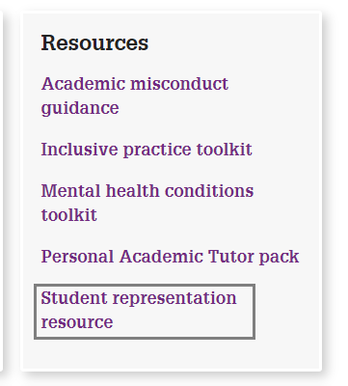
SVR STAFF RESOURCE
Total time to read:
20 mins
Notes:
AH

Slide 29
ANY QUESTIONS?
anna.templeton@uhi.ac.uk
aimee.harvey@uhi.ac.uk
andrew.bowie@uhi.ac.uk
Notes:
AH to bring AT in to facilitate Q&A section
Invite staff to share any experiences that they’ve had with SVR’s

